Slide 1
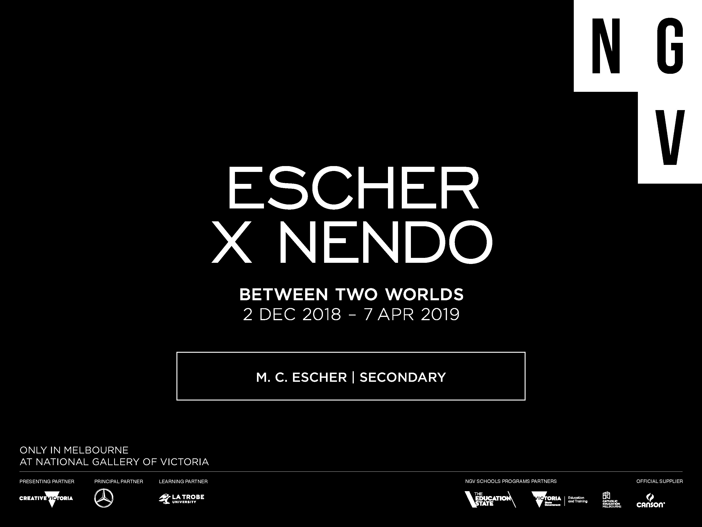

Slide 2
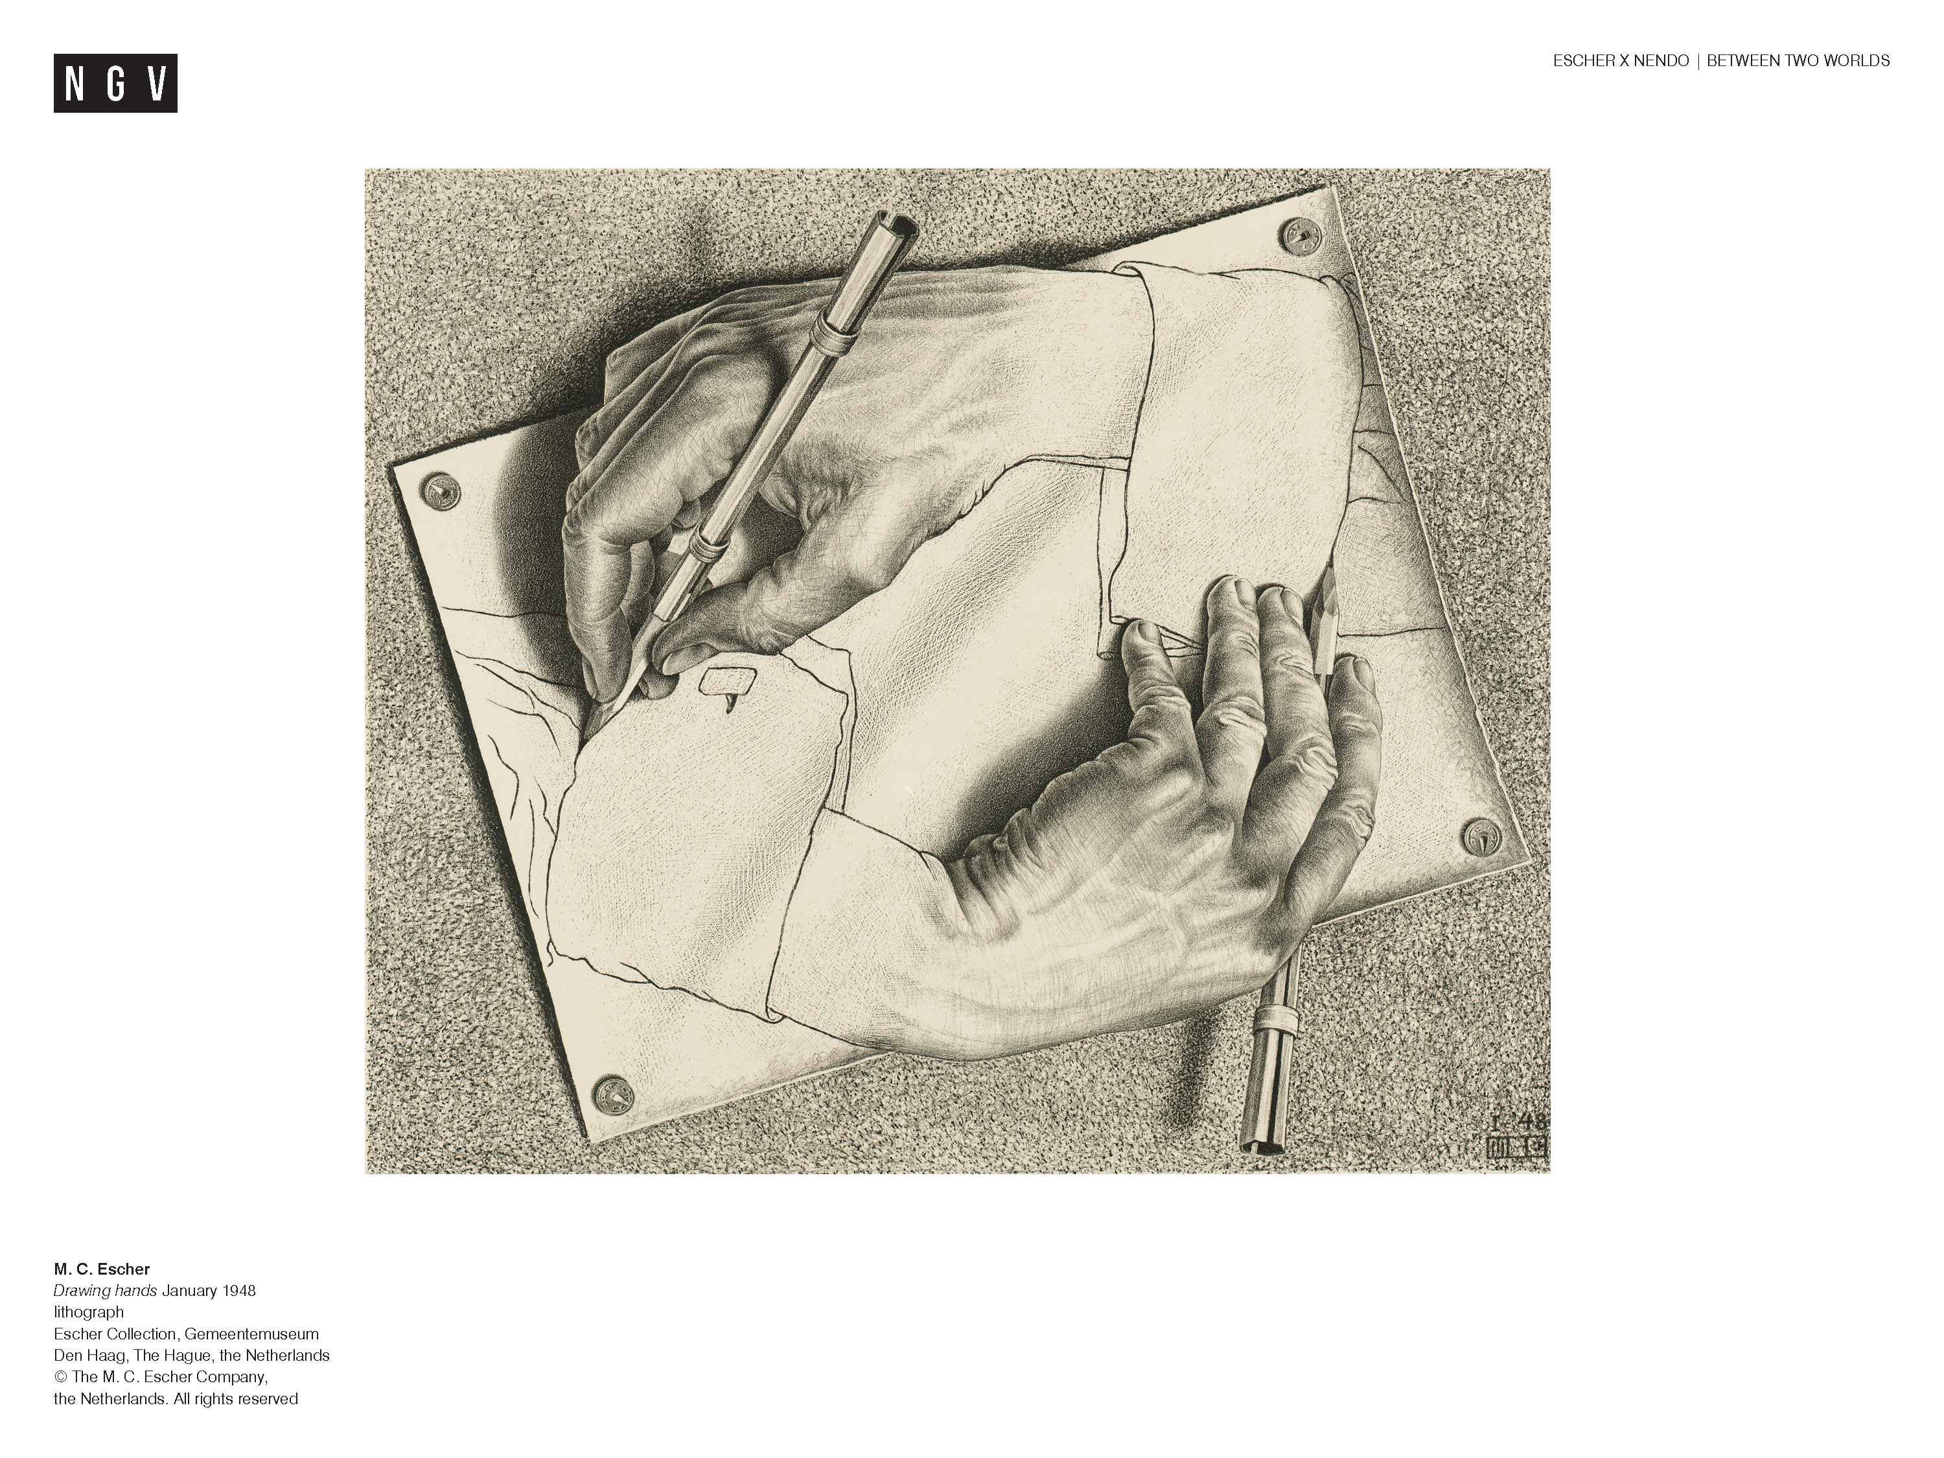
Notes:
Ask students:
What is happening in this picture? What clues does the image give you about the artist and the ideas that interested him?
Some of the ideas you might have thought of:
space and depth - two dimensions and three dimensions;
reality vs illusion; infinity – the endless cycle of hand drawing hand;
technical skill;
creativity
Maurits Cornelis Escher (1898 – 1972), known as M.C. Escher, is a Dutch graphic artist known for his detailed drawings and prints, that explore perception and illusion.
Ask students:
What is a graphic artist?
A graphic artist is one that specialises in work that exists in multiples, rather than one off paintings, drawings or illustrations.
Share this information with your students:
The exhibition Between Two Worlds introduces us to the work of M.C. Escher in an exhibition designed by Japanese design studio nendo. The exhibition is divided into sections that help us understand Escher’s work and ideas:
Early Years: Escher’s early life and influences
The Observed World: How Escher was inspired by the natural world around him
Reflection: Reflective surfaces like mirrors and metal and the altered view of reality that these surfaces present
Regular division of the plane: Escher’s fascination with pattern and tessellation
Space and illusion: Exploration of two and three dimensions and our human perception of them
Infinity and impossible worlds : Depicting the concept of endlessness and making us believe in realities that could not exist in ‘real life’.

Slide 3
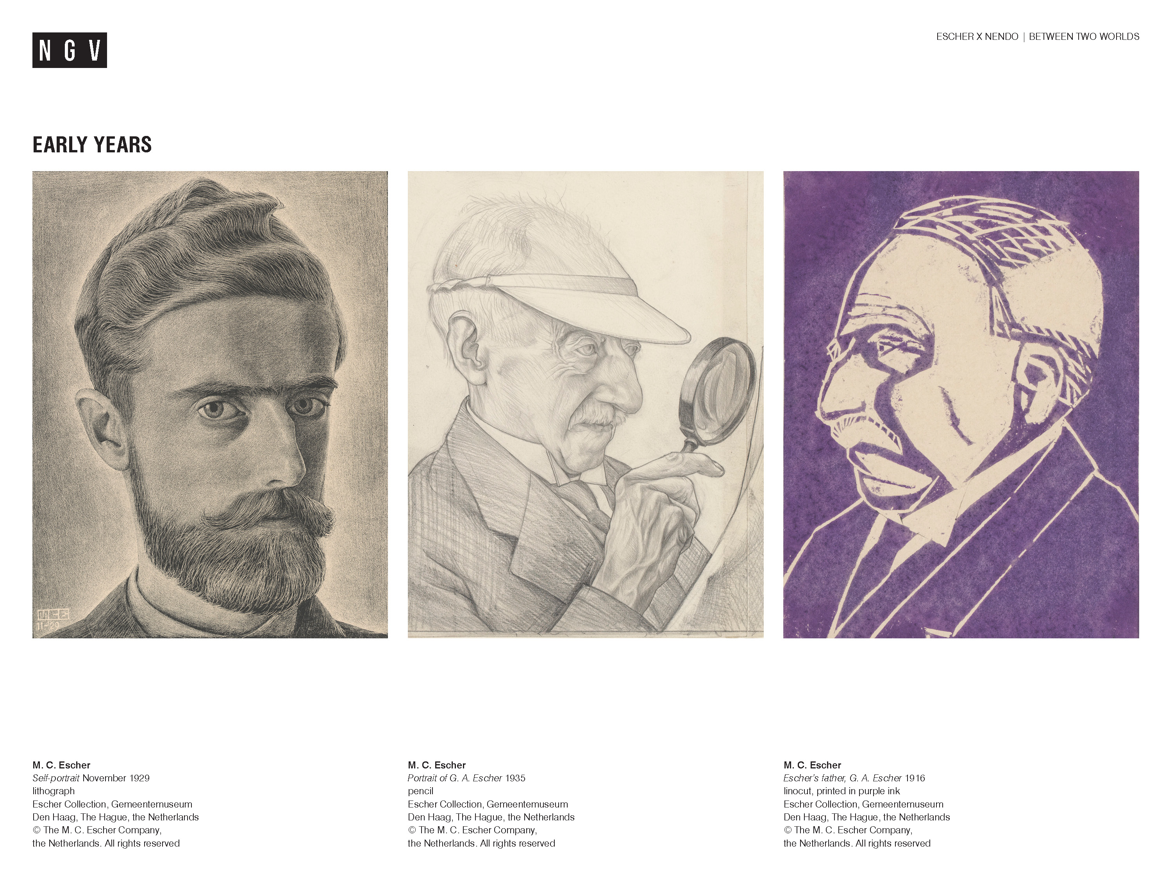
Notes:
Share this information with your students:
Early Years
Self portrait,1928:
This a self portrait made by Escher when he was thirty one years old.
Maurits Cornelis Escher was born in 1898 in the Netherlands, to George Arnold Escher and Sarah Gleichman.
He was the youngest of five sons, two of whom were from his father’s previous marriage.
His family and friends called him ‘Mauk’.
Maurits Escher was very close to his father, George (pictured here at age 73 and 92).
Maurtis Escher was a very bright, but not a very successful student. He didn’t like school and failed his final high school exams.
He did enjoy his art lessons at school and one of his art teachers introduced him to printmaking.
The picture on the right was the first lino cut print Escher produced…an image of his father. The middle image was an image of his father at 92 years old made four years before he died.
Escher’s parents wanted him to become an architect, but after enrolling in the School for Architecture and Decorative Arts in Haarlem he switched to a Graphic arts course, with the encouragement of one of the school’s teachers Samuel Jessurun de Mesquita, who would be a strong mentor for Escher.

Slide 4
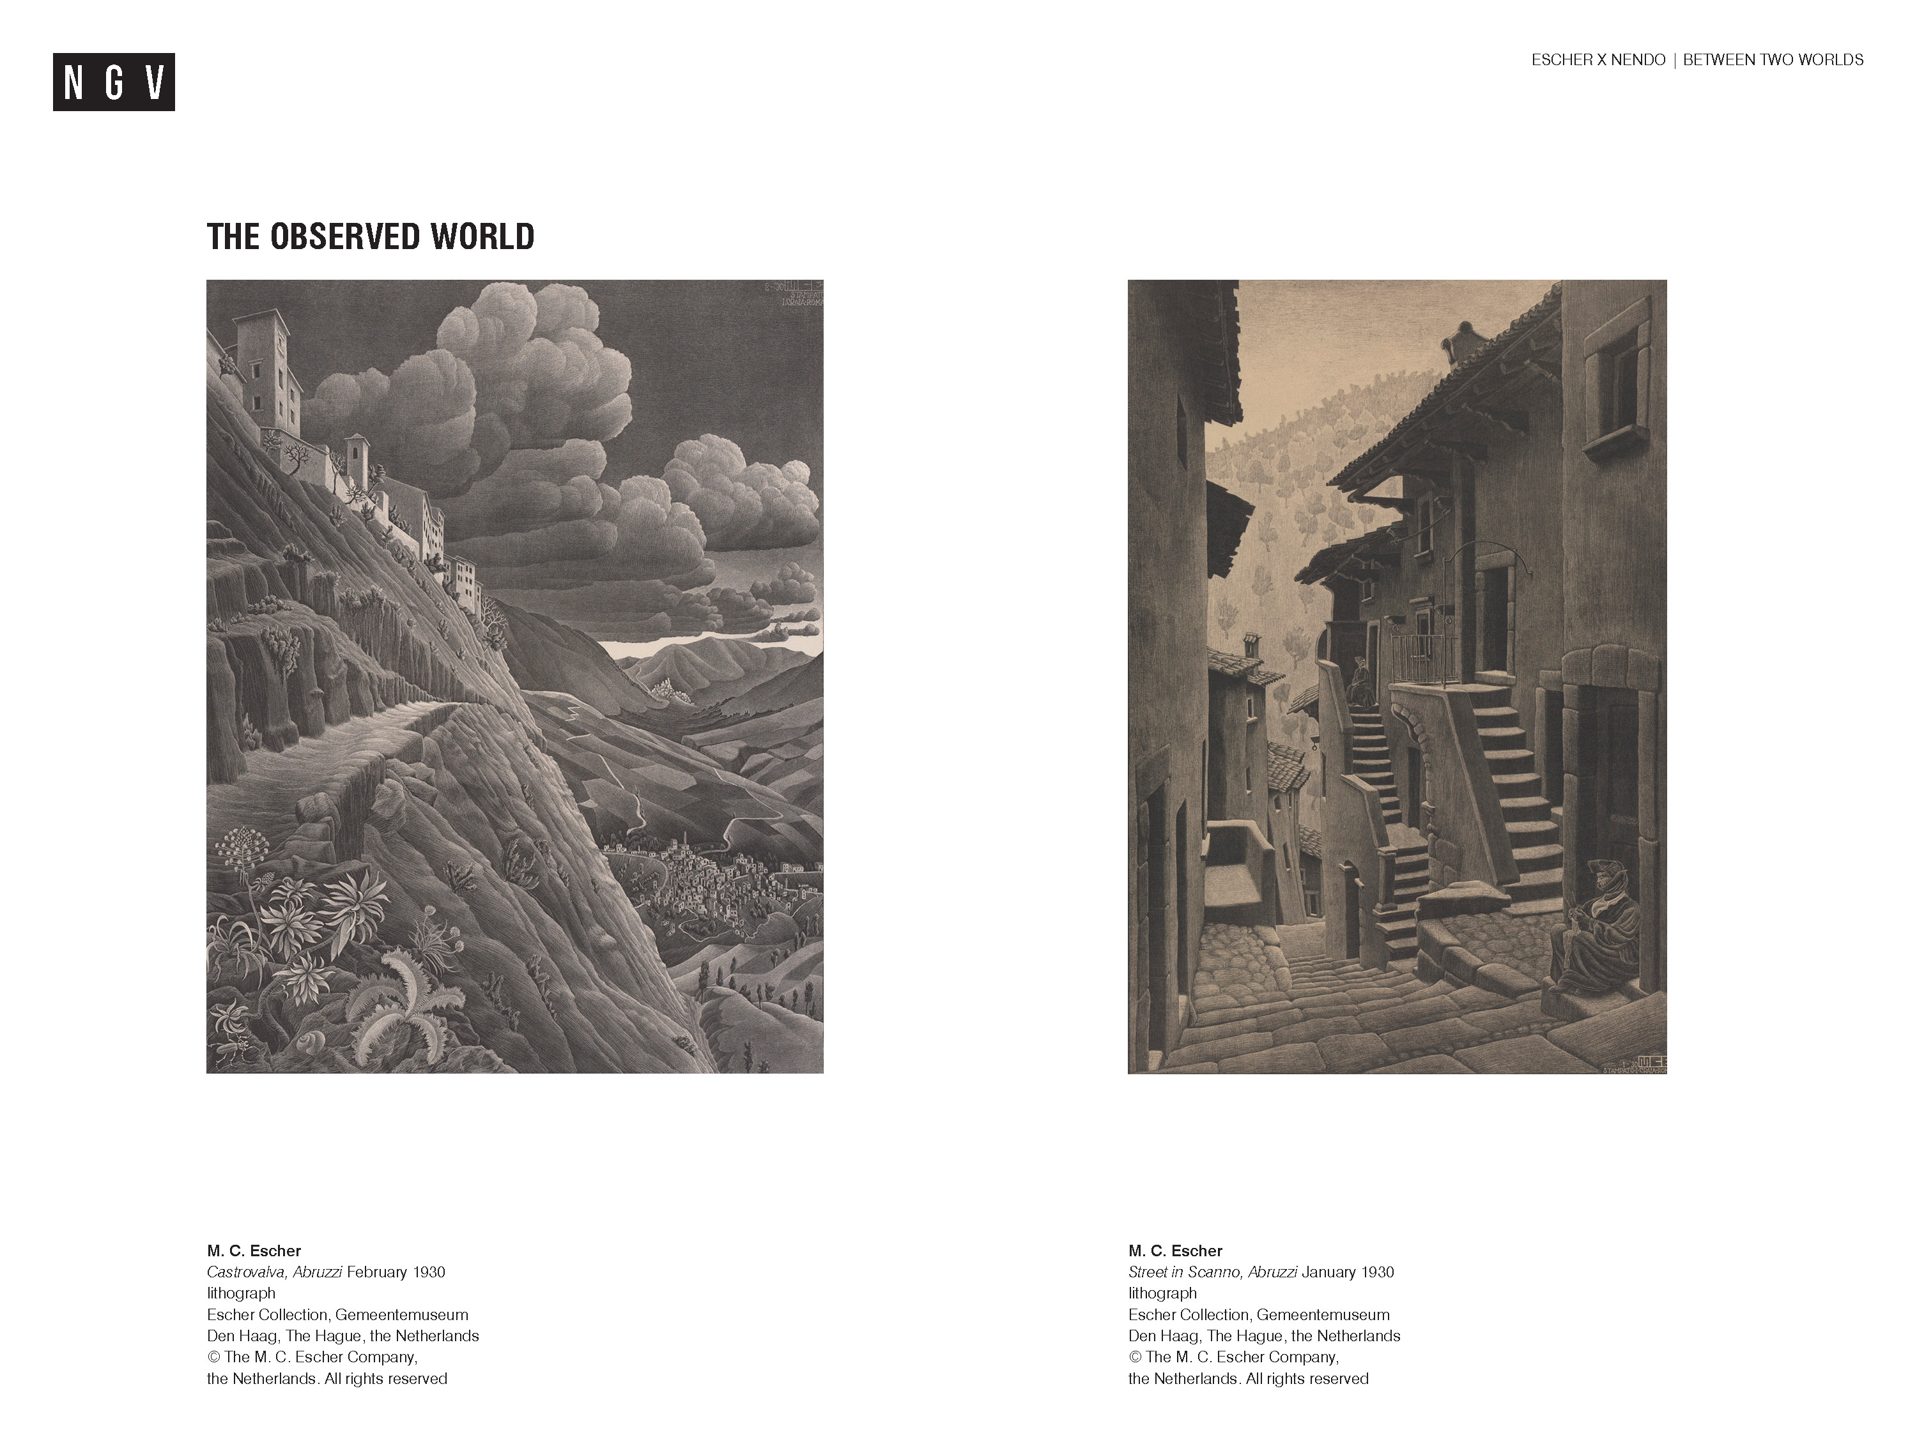
Notes:
Share this information with your students:
At the end of his studies Escher travelled to Italy with friends, visiting different parts of the country and sketching as he went.
Italy became Escher’s home for thirteen years.
Each spring Escher would journey around Italy. The detailed sketches and photographs he gathered formed the basis for prints he made later, including those pictured here.
Castrovalva (on the left) and Scanno (in the image on the right) are villages in the mountainous region of Abruzzo, east of Rome.
Ask students:
What kinds of adjectives would you use to describe these prints? For example, are they messy/neat/detailed/rough/dramatic/boring? Give reasons for your answer.
To what extent do you think they are an accurate depiction of the landscape?
Share this information with your students:
Escher shows an eye for detail, showing very close observation of nature and the built environment, but he doesn’t represent landscapes in the Abruzzo region exactly as they appear. He distorts and emphasises aspects of reality to create drama and to heighten emotional qualities.
Ask students:
What opposites or contrasts can you notice in the prints? How has Escher manipulated aspects of the image to create drama? Which elements are emphasised? Distorted? How would you describe the emotional qualities that are created? What details do you notice on closer inspection and why do you think the artist has included them?

Slide 5
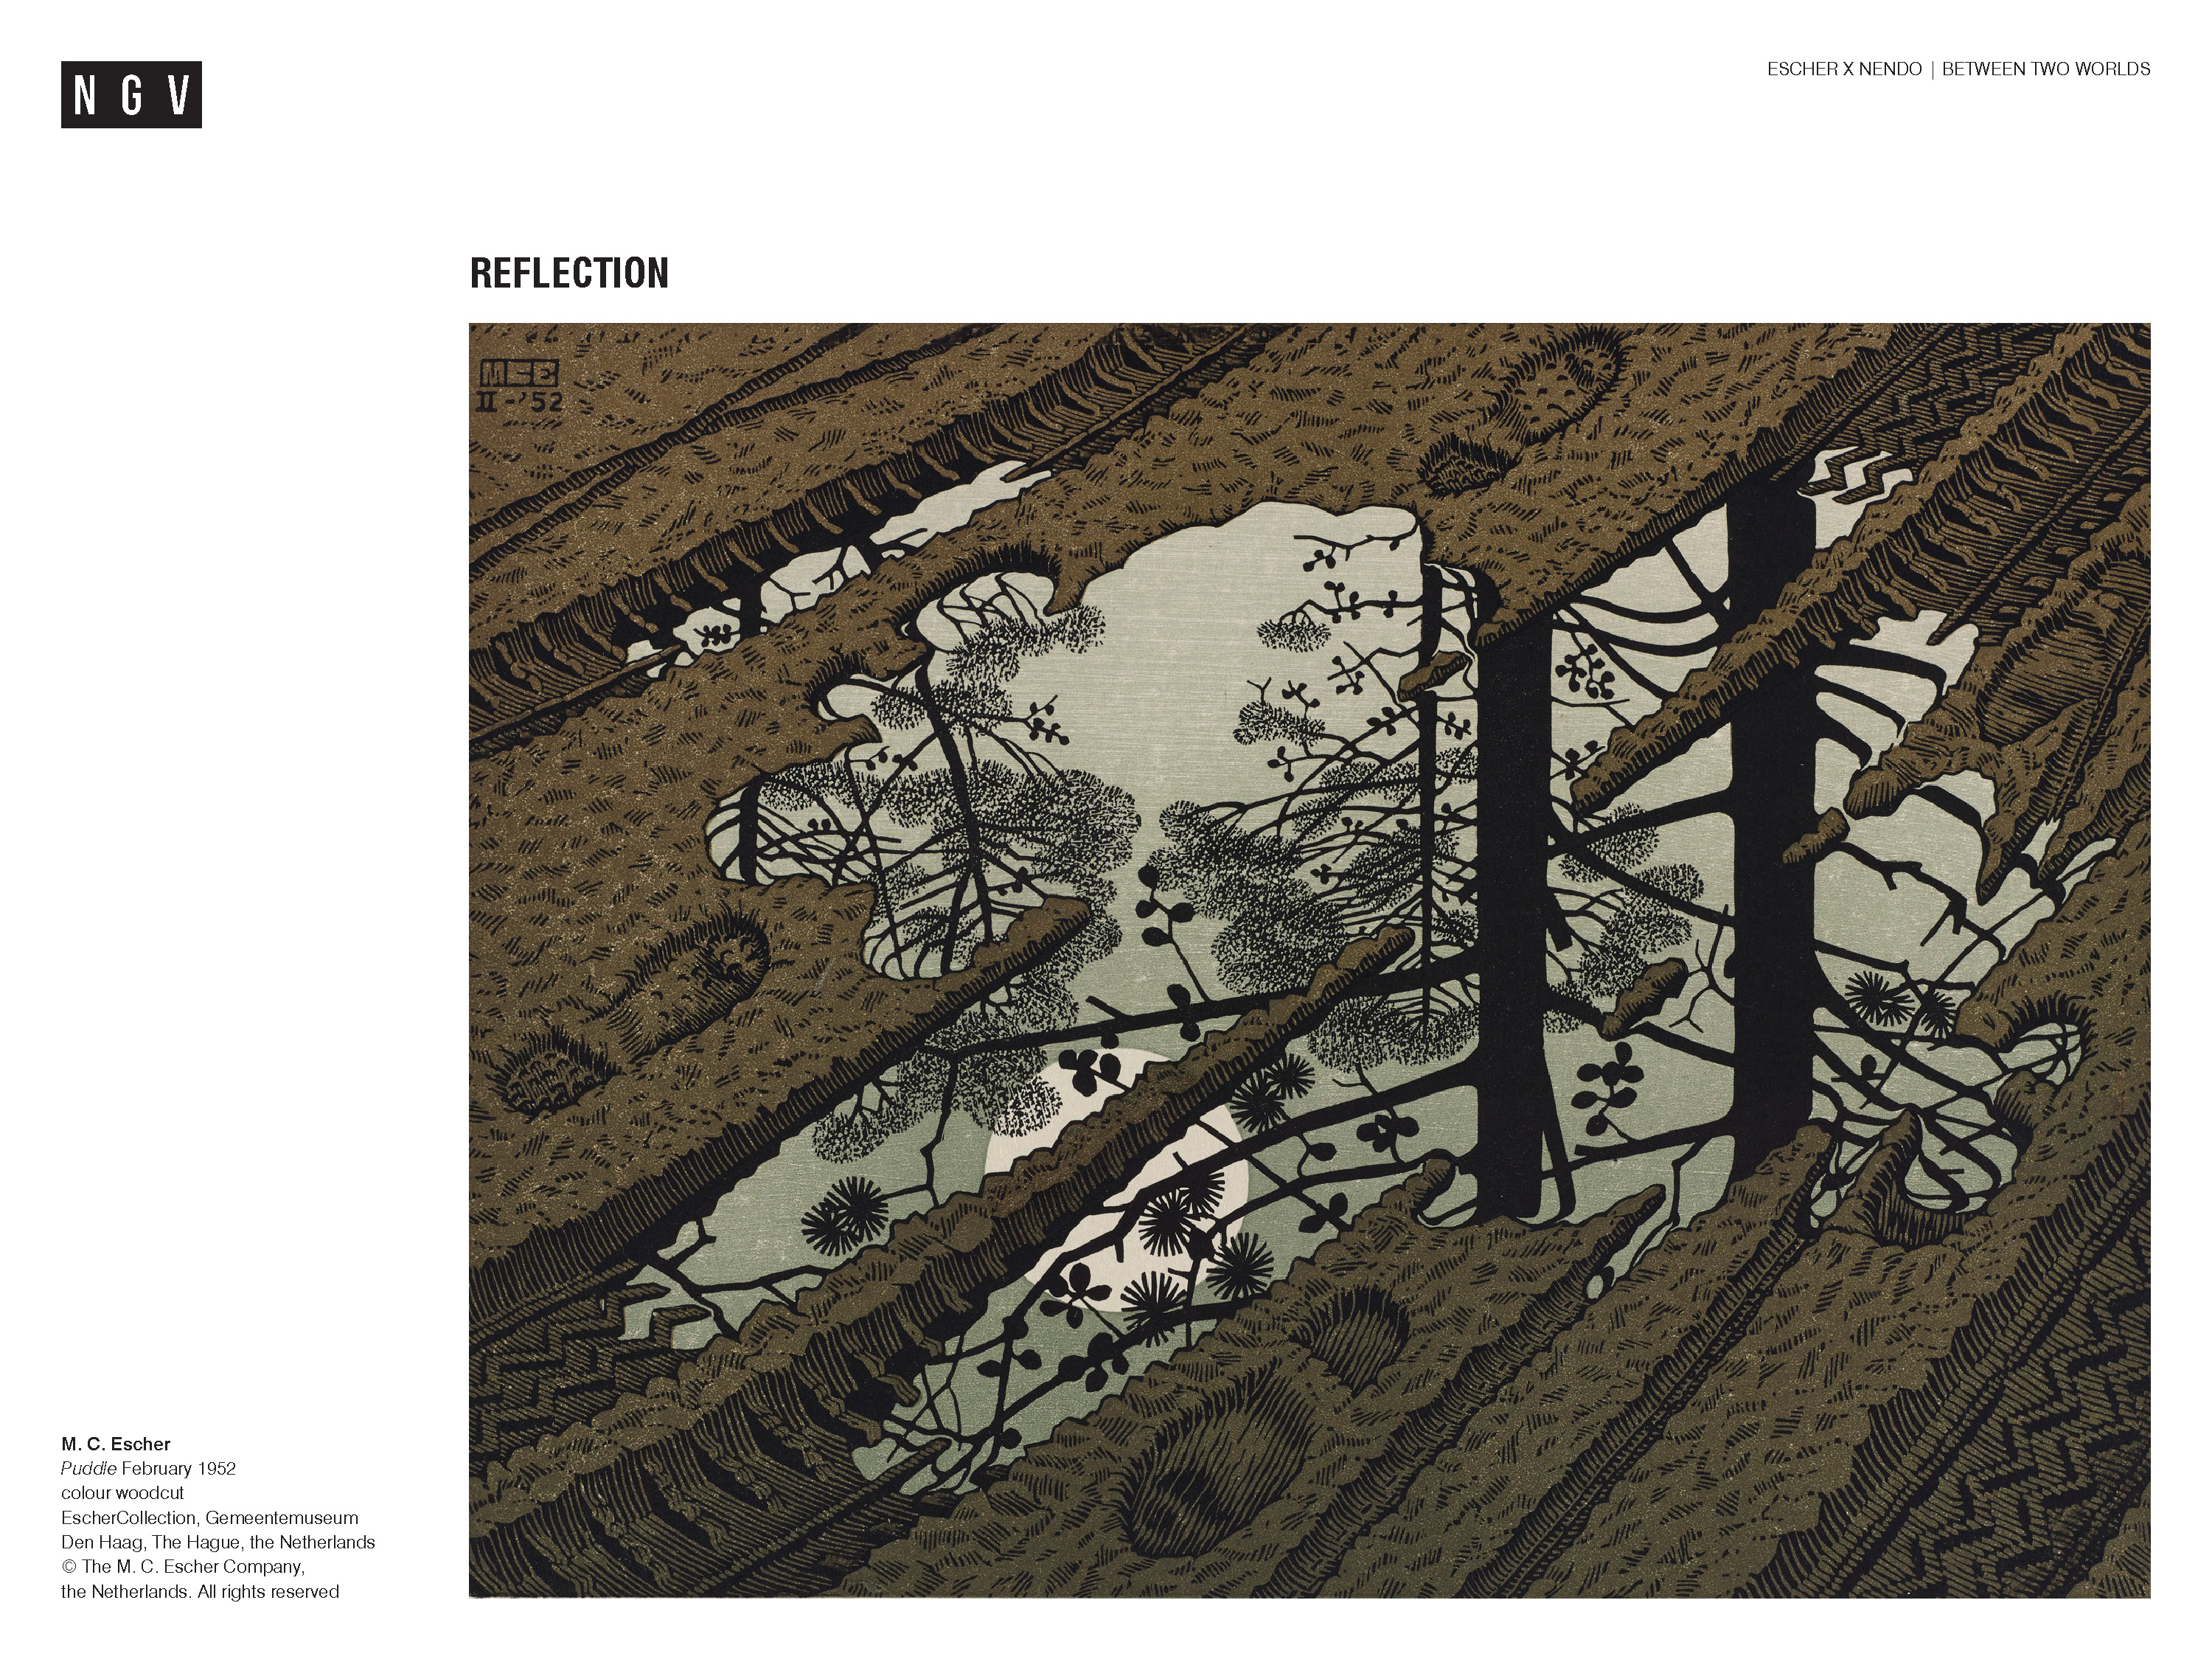
Notes:
Ask students:
What does the word ‘reflection’ mean?
Share this information with your students:
Reflection can be how a surface bounces light back to your eye to produce a mirror image, or it can be quiet contemplation or thought.
Escher produced many prints that included reflections. The images depict reflections of the real world in mirrored surfaces but also hint at other ideas.
This image shows a woodcut print made in 1952.
Ask students:
Describe what you notice in the image to the person next to you.
For example, a full moon behind trees is reflected in a puddle on a muddy road.
What kind of traffic has passed down the road?
For example, bicycles, cars and people on foot.
What time of year might it be? What is it about the work that suggests this?
Which elements are evident in the picture?
For example, water, earth, air – but also: line, colour, texture etc.
What big ideas or themes could be read into the work?
For example, beauty in the everyday, worlds within worlds, looking down at the path while missing the magic above, human busyness versus the quiet cycles of nature.

Slide 6
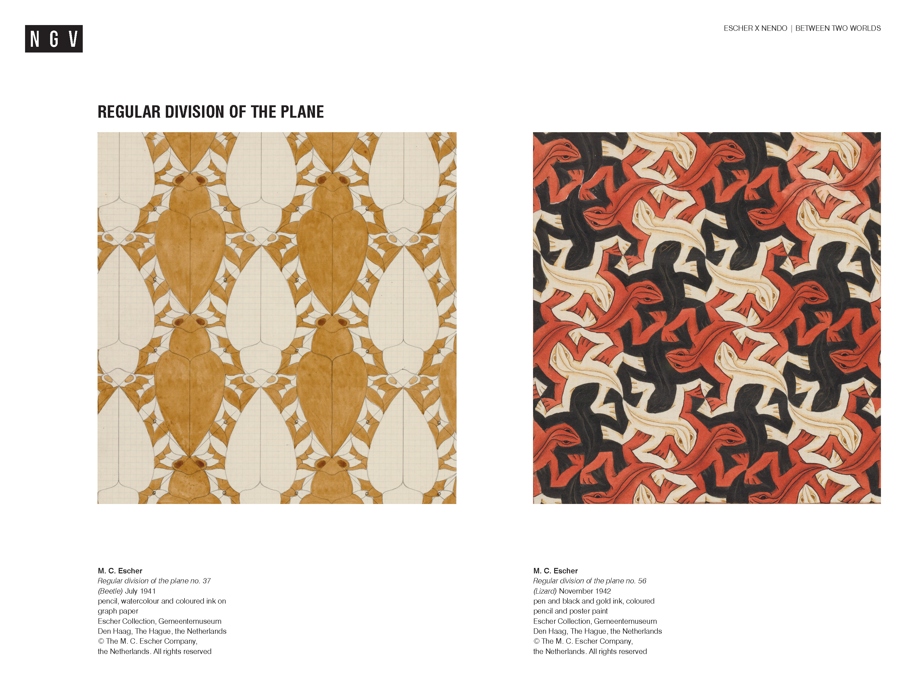
Notes:
Share this information with your students:
Escher visited the Alhambra palace in Spain in 1936. The Alhambra is a 14th C Moorish palace fortress full of surfaces decorated in repeating patterns of tiles.
Escher filled sketchbooks with drawings of the designs he saw. Escher became fascinated with the idea of filling flat surfaces – planes – with interlocking repeated patterns. Unlike the Moorish artists who didn’t use recognisable forms and figures – only abstract shapes and patterns, Escher chose to create figures and creatures to repeat and interlock. He called this plane filling or regular division of the plane. He research different ways of making interlocking repetitions. His brother Berend – a geologist - introduced him to a scientific field called crystallography and the mathematical structures behind the formation of crystals. This helped Escher understand the mathematics that underpinned tessellated patterns – patterns of repeating shapes with no gaps.
Escher’s interest in pattern, repetition and mathematical structures made his work of interest to mathematicians and he was in turn inspired by them.
Escher said:
Mathematics germinates from the same root as poetry, that is, from the gift of the imagination. ¹
M.C. Escher
¹ M. C. Escher quoted in M. C. Escher & Janet Wilson (ed.), Escher on Escher: Exploring the Infinite, trans.
Karin Ford, Harry N. Abrams, New York, 1989, p. 150.

Slide 7
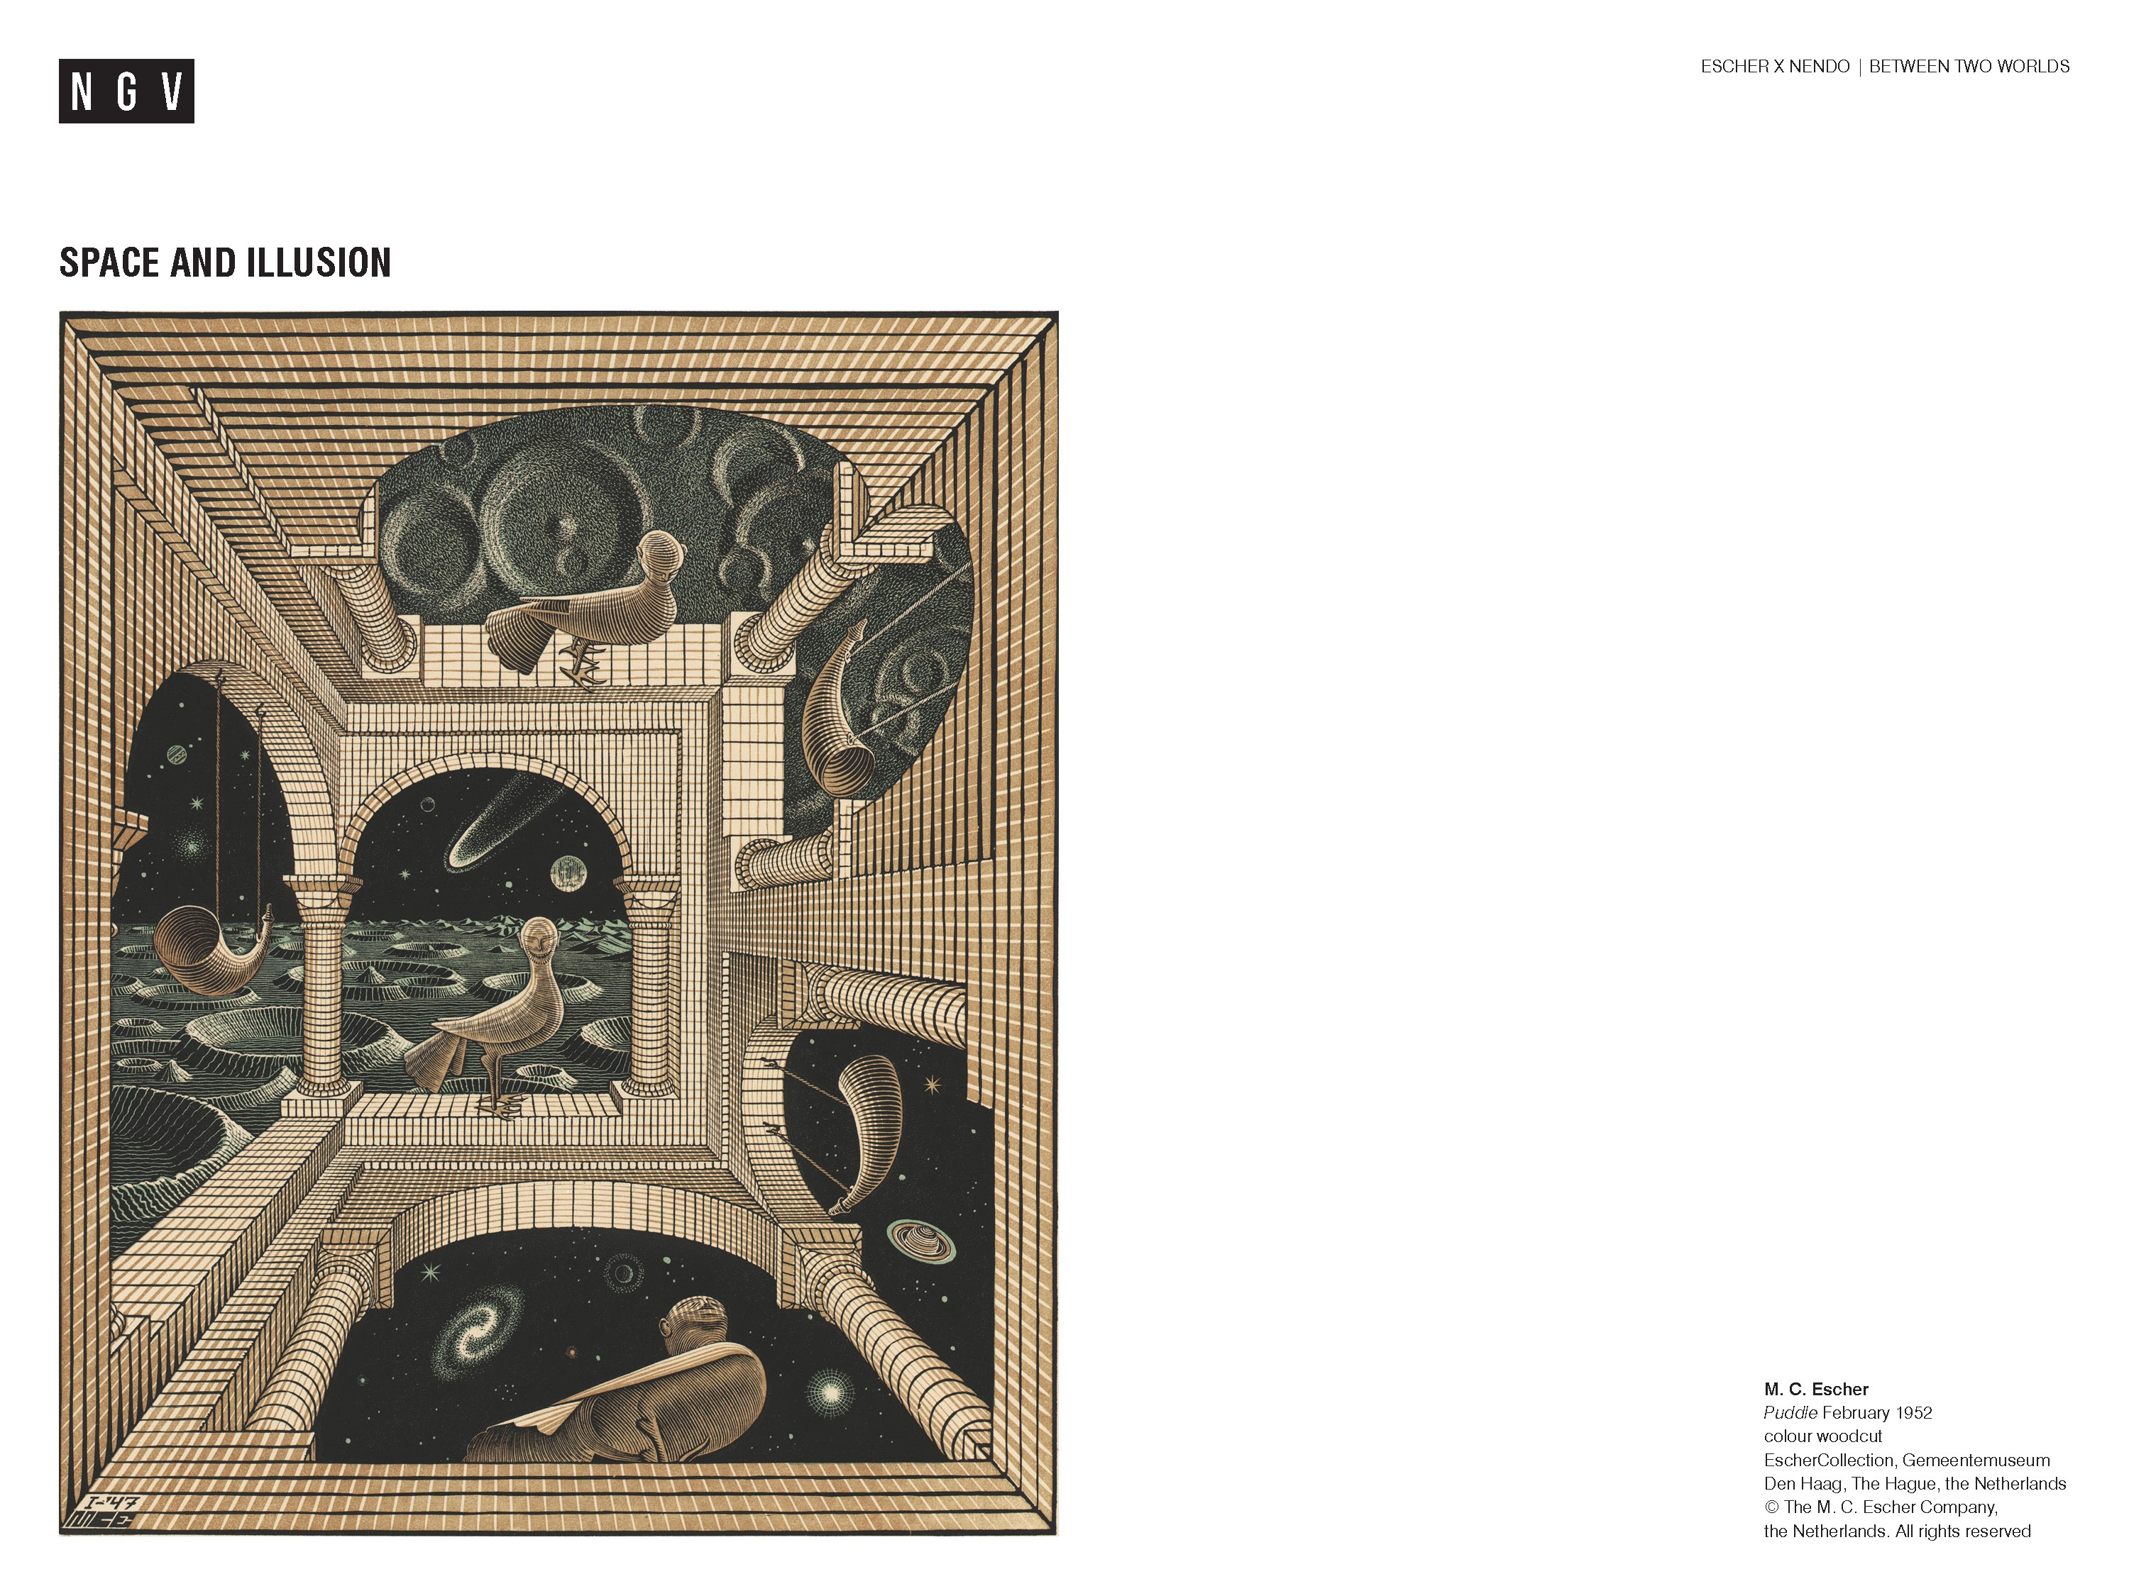
Notes:
Another idea that fascinated Escher was how to both represent and how to manipulate our perception of space.
Ask students:
How many viewpoints can you see in this image?
Could this structure exist in real life? Why/why not?
Share this information with your students:
The image is a paradox – a visual proposition with contradictory elements that are related to each other. if one is true the other must be false. What is a floor in one perspective becomes a ceiling in another… but this creates the impossible situation of the bird figure hanging upside down defying gravity. Different realities coexist in the one image.
Another famous example of a paradox is called the Liar’s paradox: ‘This sentence is a lie.’ If the sentence is not a lie, then, paradoxically the sentence is true, thereby contradicting the words of the sentence.
Similarly, the statement: ‘I only ever tell lies.’
If this is true, then the statement must be a lie, which means that the subject sometimes tell the truth, which contradicts the statement.
This print Other world, 1947, is a colour woodblock print, printed from three blocks, one from each of the colours.
The bird figure with a human face was based on a sculpture given to Escher by his father-in-law.
Escher’s father had introduced his family to astronomy and the stars through a telescope set up on the roof of the family home.
Escher said: I am always wandering around in enigmas.²
M.C. Escher
² M. C. Escher quoted in J. L. Locher, The Magic of M.C. Escher, Thames & Hudson, London, 2013, p. 101.

Slide 8
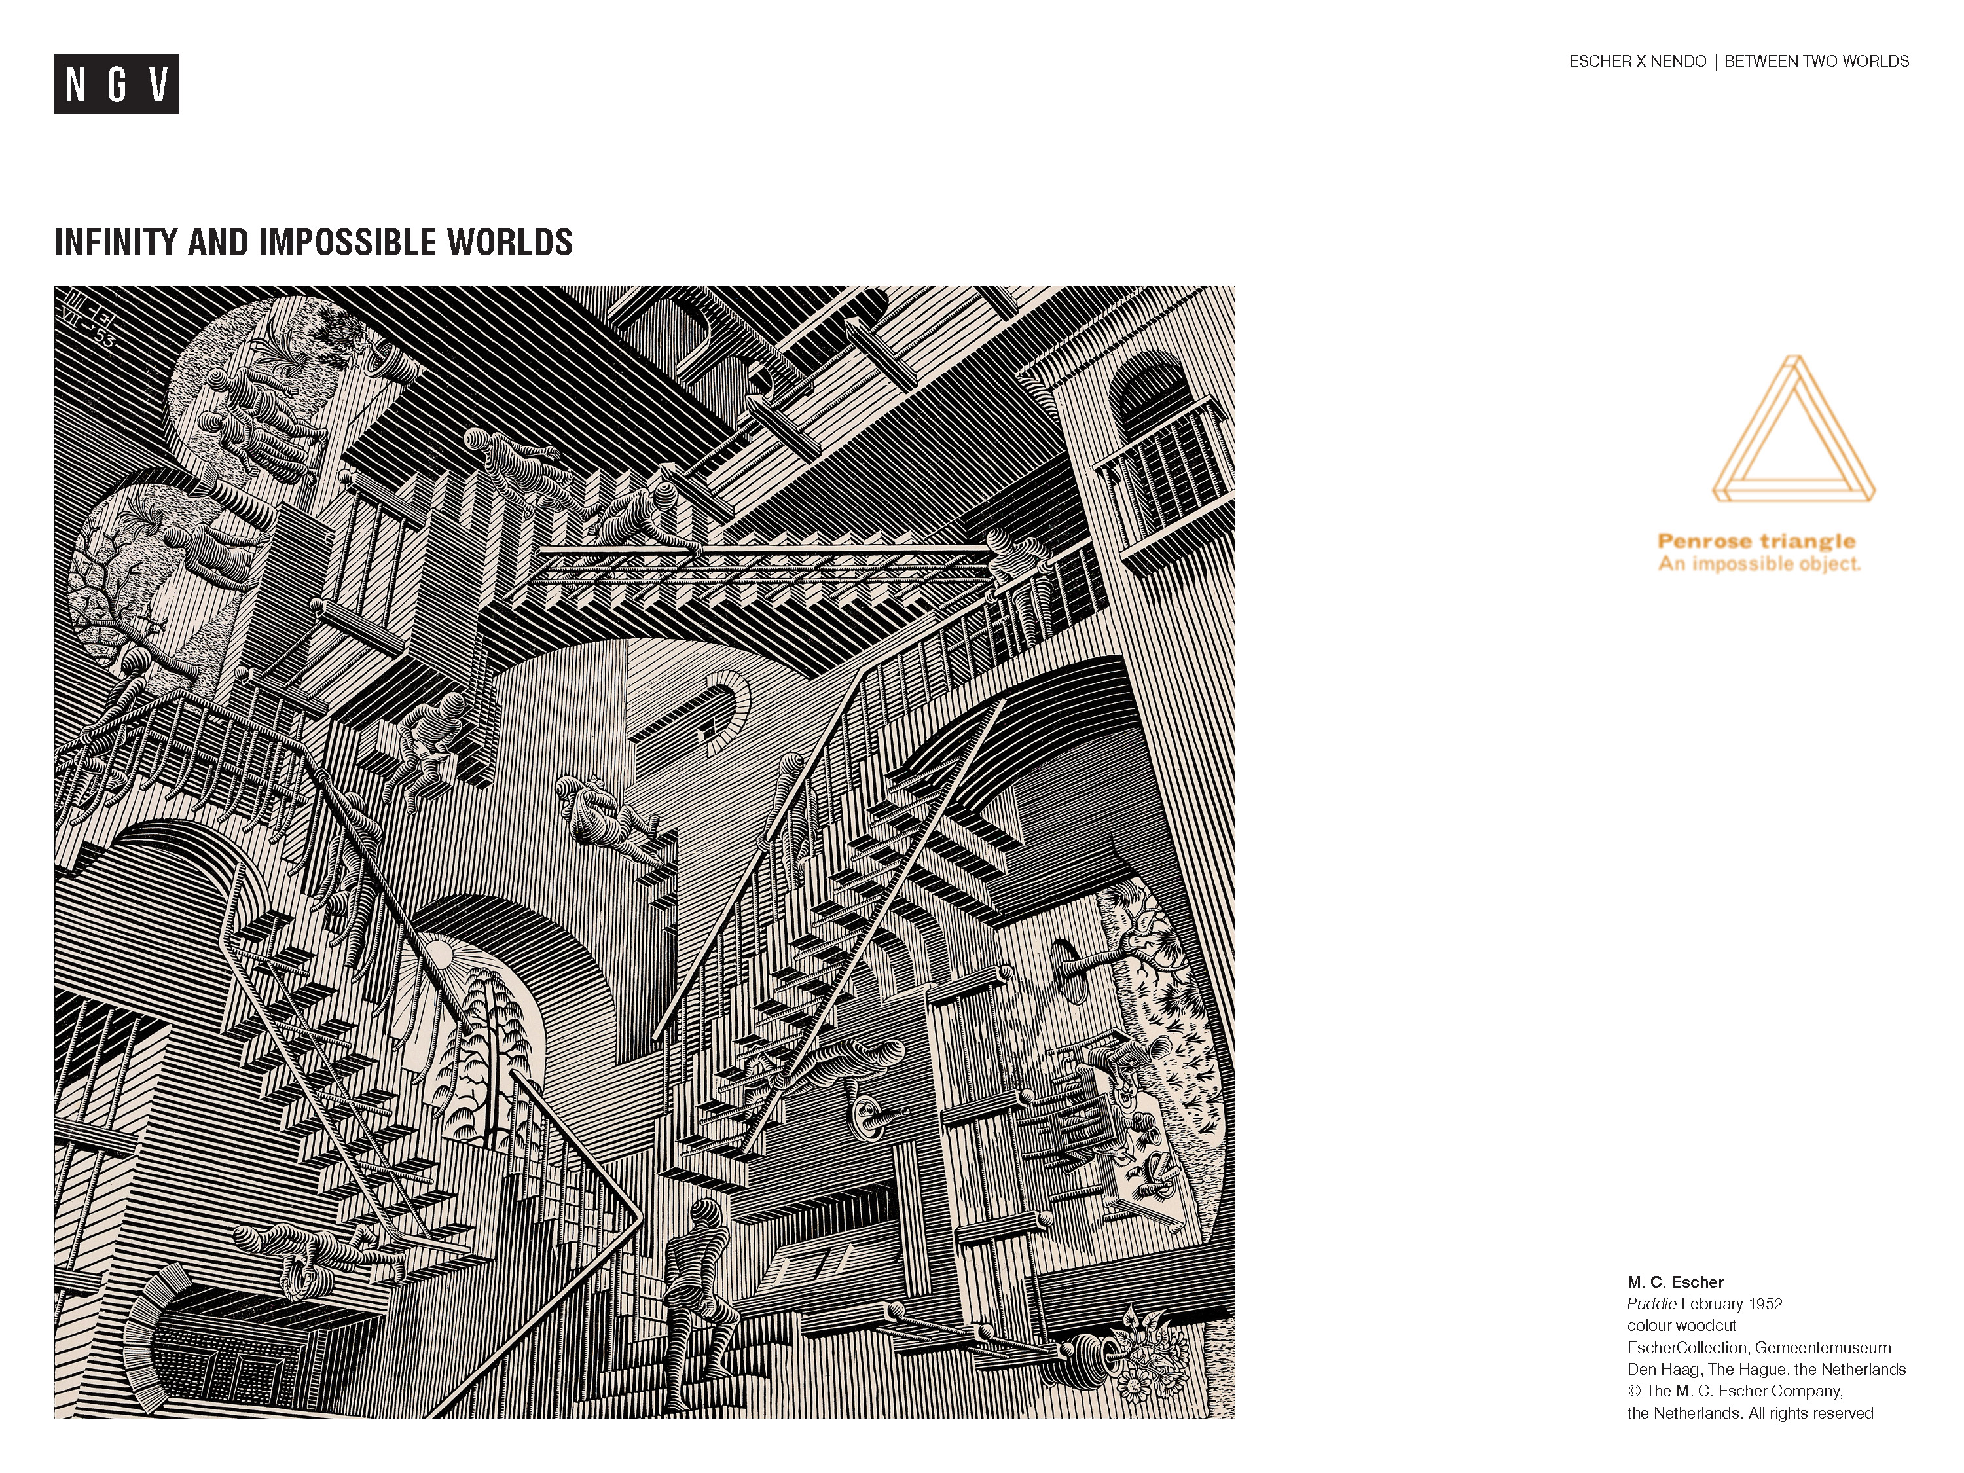
Notes:
Share this information with your students:
In 1954 an exhibition of Escher’s prints was organised to coincide with the International Congress of Mathematicians in Amsterdam. Viewed by hundreds of delegates, it was responsible for igniting interest in his work among the mathematical community around the world. Two of the mathematicians who saw Escher’s prints corresponded with him, providing ideas for new work and solutions to problems he had been unable to resolve.
One of these was a young British mathematician Roger Penrose (b.1931) who recalled being ‘completely stunned by the ingenuity, the artistry, the mathematical understanding and precision, the toying with contradiction, and the sheer boldness of originality exhibited by these [Escher’s] pictures’.
Psychiatrist Lionel Penrose and his mathematician son Roger devised and popularized an impossible figure (which became known as the Penrose triangle) in the 1950s, partly inspired by Escher’s earlier depictions of impossible objects. The impossible objects they created inspired Escher to create further works, like Ascending and Descending, 1960 (not pictured).
The Penrose triangle is an impossible object: a two-dimensional figure, interpreted as a three-dimensional object. It is geometrically impossible to represent the Penrose triangle in the physical world. The curious, impossible property of the Penrose triangle is that each side seems to be ahead of the previous side. Escher didn’t know of the Penrose triangle until 1958, five years after this image was produced!
The impossible triangle
Escher uses impossible figures like the Penrose triangle to explore the concept of infinity.
Ask students:
Could this building/structure exist in the real world? How does your brain make sense of what you are observing?
We can only make logical sense of part of the image at a time. Escher played with what we think of as certainties. He asked:
Are you sure that a floor cannot also be a ceiling? Are you absolutely certain that you go up when you walk up a staircase? ³
M. C. Escher, 1965
³ M.C. Escher, Escher on Escher: Exploring the Infinite, Harry N. Abrahams, Inc., NY, 1989, p. 21.

