Slide 1
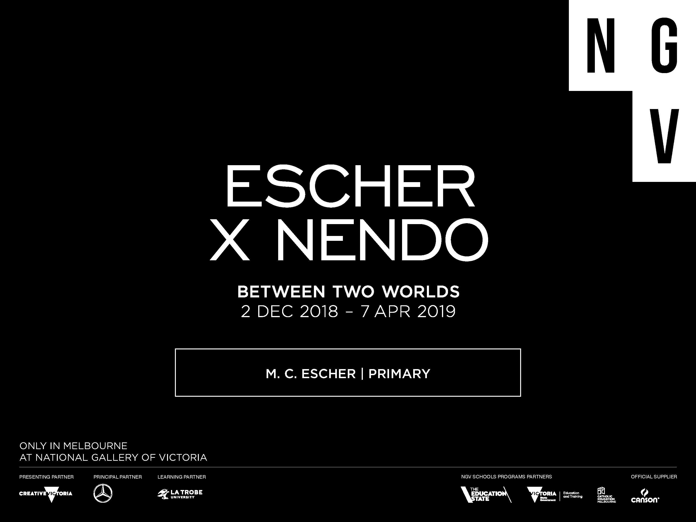

Slide 2
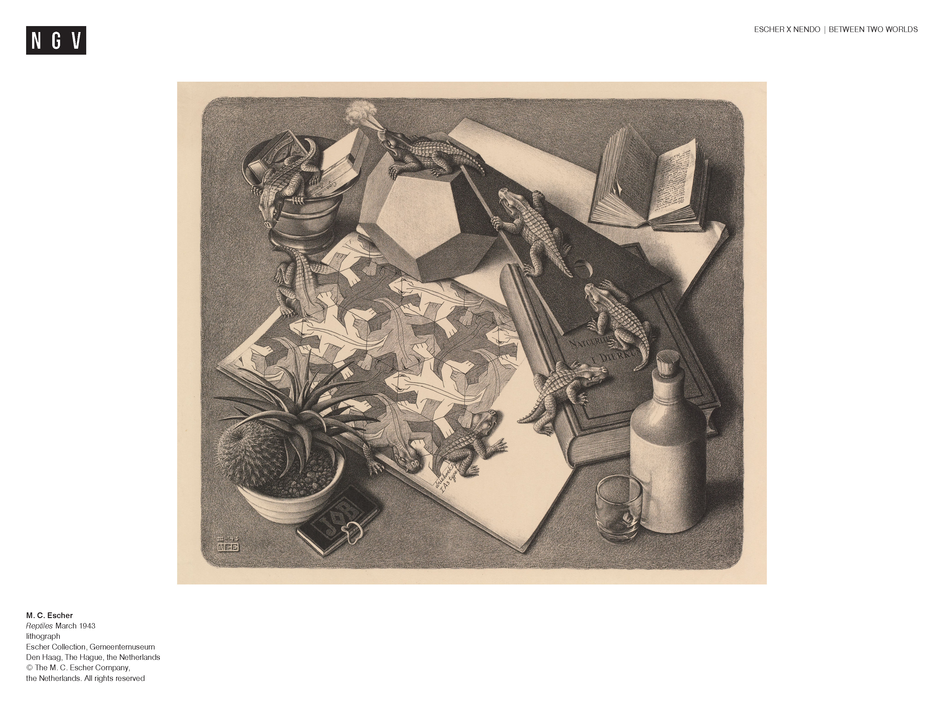
Notes:
M.C. Escher | Between Two Worlds
Primary Levels 2-6
Ask students:
What is happening in this picture? What clues does the image give you about the artist and the ideas that interested him?
Some of the ideas you might have thought of:
Space and depth - two dimensions and three dimensions;
Reality vs illusion; infinity – the endless cycle of of lizards from the page to ‘real life’;
Tessellating patterns;
Creativity and technical skill;
Geometry - polyhedrons
About the exhibition:
The exhibition Between Two Worlds introduces us to the work of M.C. Escher in an exhibition designed by Japanese design studio nendo. The exhibition is divided into sections that help us understand Escher’s work and ideas:
Early Years: Escher’s early life and influences
The Observed World: How Escher was inspired by the natural world around him
Reflection: Reflective surfaces like mirrors and metal and the altered view of reality that these surfaces present
Regular division of the plane: Escher’s fascination with pattern and tessellation
Space and illusion: Exploration of two and three dimensions and how we perceive them
Infinity and impossible worlds : Depicting the concept of endlessness and making us believe in realities that could not exist in ‘real life’.

Slide 3
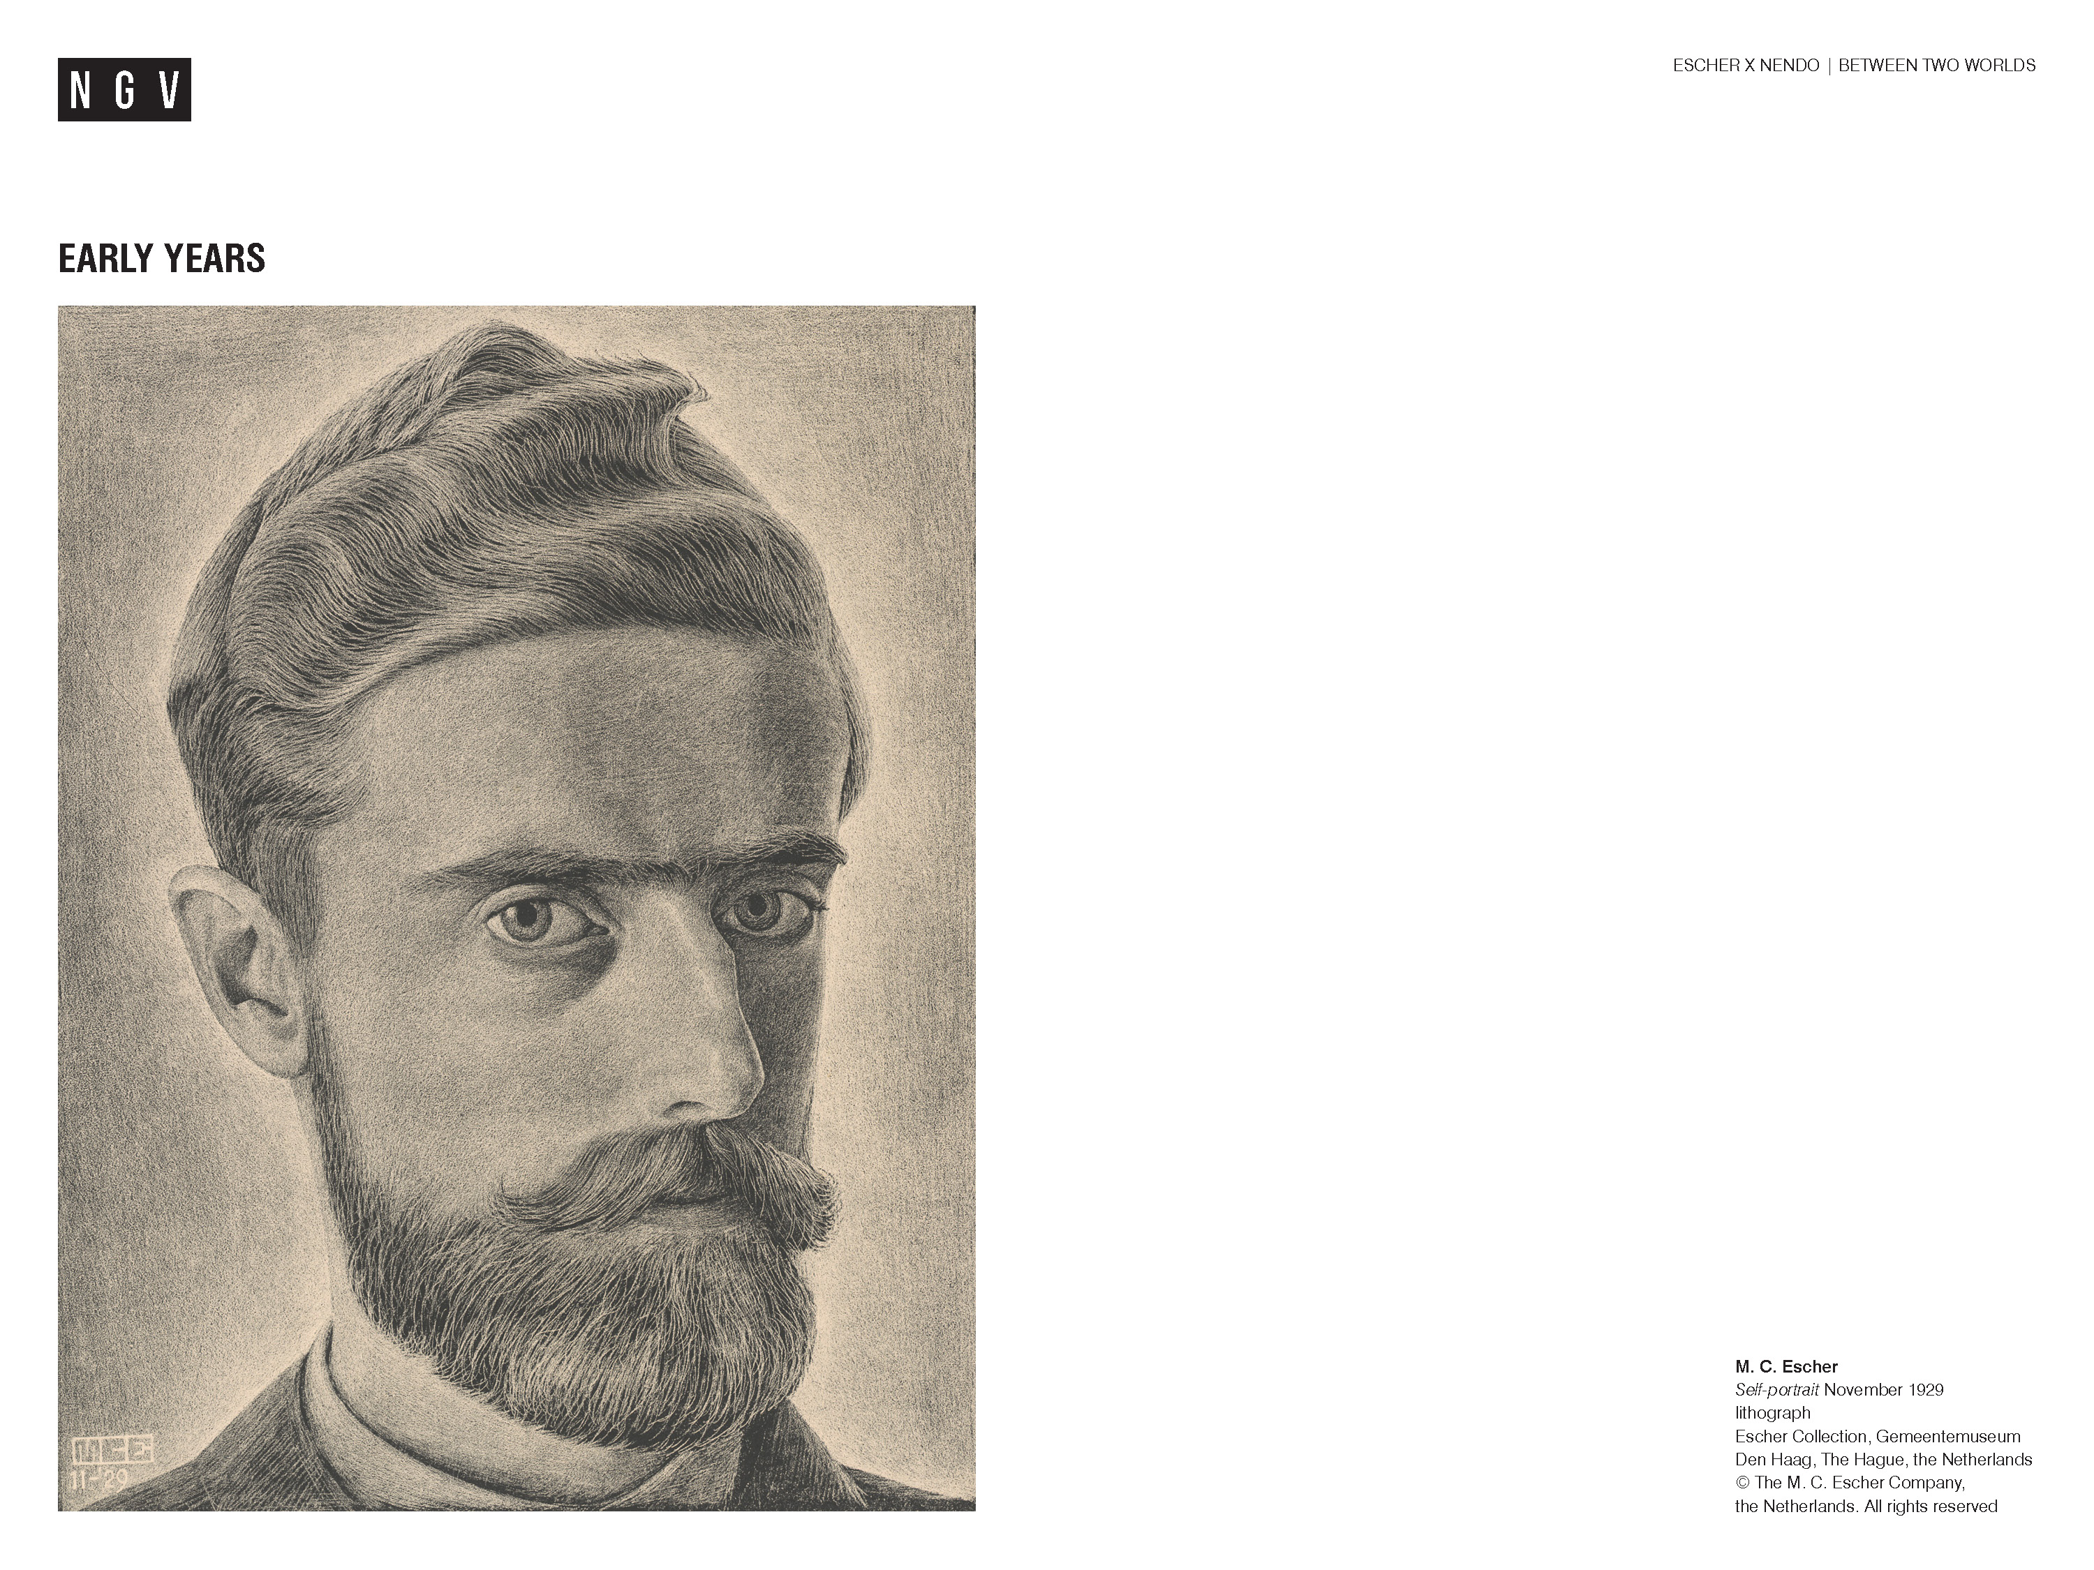
Notes:
Ask students:
What can we know about Escher by looking at his portrait?
Share this information with your students:
Maurits Cornelis Escher (1898-1972) was a Dutch artist, best known for his graphic art and celebrated as the master of optical illusions.
Escher was born in the Netherlands on 17 June, 1898. Known as ‘Mauk’ by his family, he was the fifth and youngest child of George and Sarah Escher. When he was five years old, his family moved to Arnhem, where he spent most of his childhood.
Despite Escher’s talents, he didn’t experience many successes throughout his schooling. In fact, he failed his high school exams! Escher went on to study architecture, but this quickly changed. One of his teachers saw Escher’s drawings and prints and encouraged him to study graphic art and printmaking. After finishing art school, he travelled to Italy and met his wife, Jetta Umiker. They moved to Rome and lived there for 11 years. Two of their sons, George and Arthur, were born in Italy. During this time, Escher travelled extensively throughout Italy, drawing and sketching along the way. These sketches would become prints when he returned home following each trip.

Slide 4
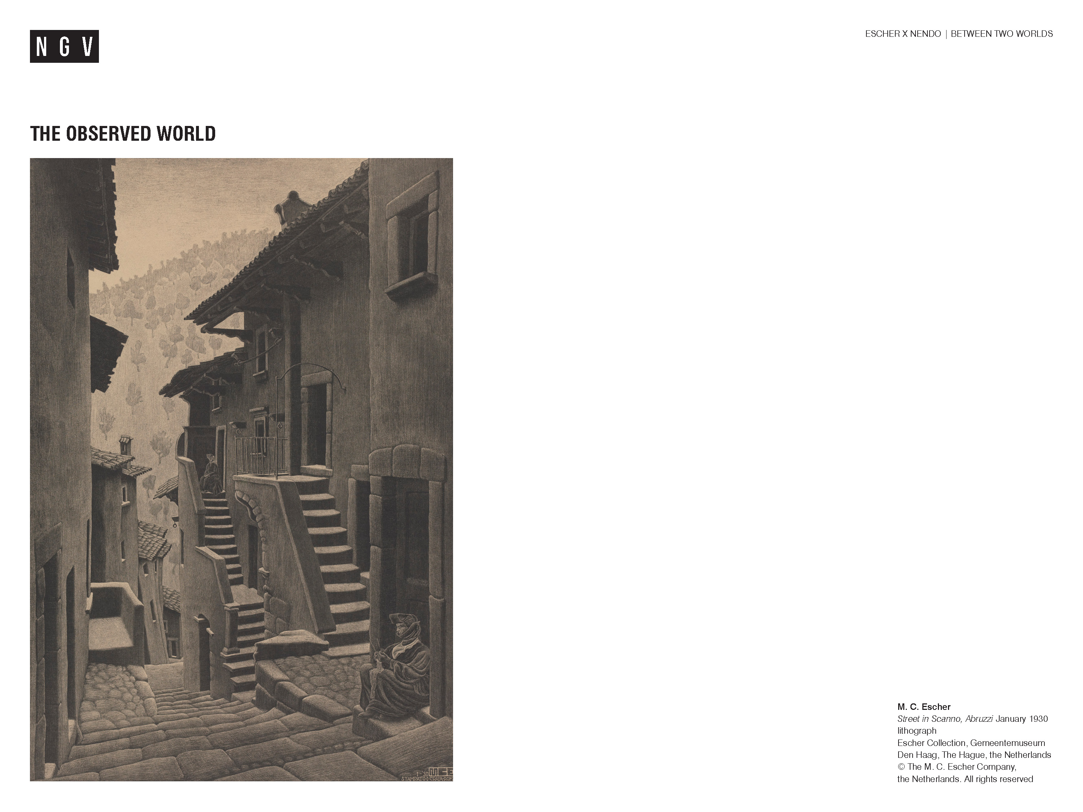
Notes:
Ask students:
Describe the features of this town. Where in the world might this town be?
Why do you think Escher was inspired to recreate this town in his work?
This is the town, Scanno, one of the places Escher visited in Southern Italy. Known as an enchanting medieval town, old buildings are spread across a hilltop and surrounded by mountains. Can you see the mountain in Escher’s print? Steep, narrow streets and alleyways divide the town. Cobblestone pathways, stone houses and arch gateways are a delight to visitors. This is what Escher would’ve loved when he visited the south of Italy. He was inspired to draw the environment around him; his observed world.
Ask students:
Can you think of places that you like to visit? What makes them special?

Slide 5
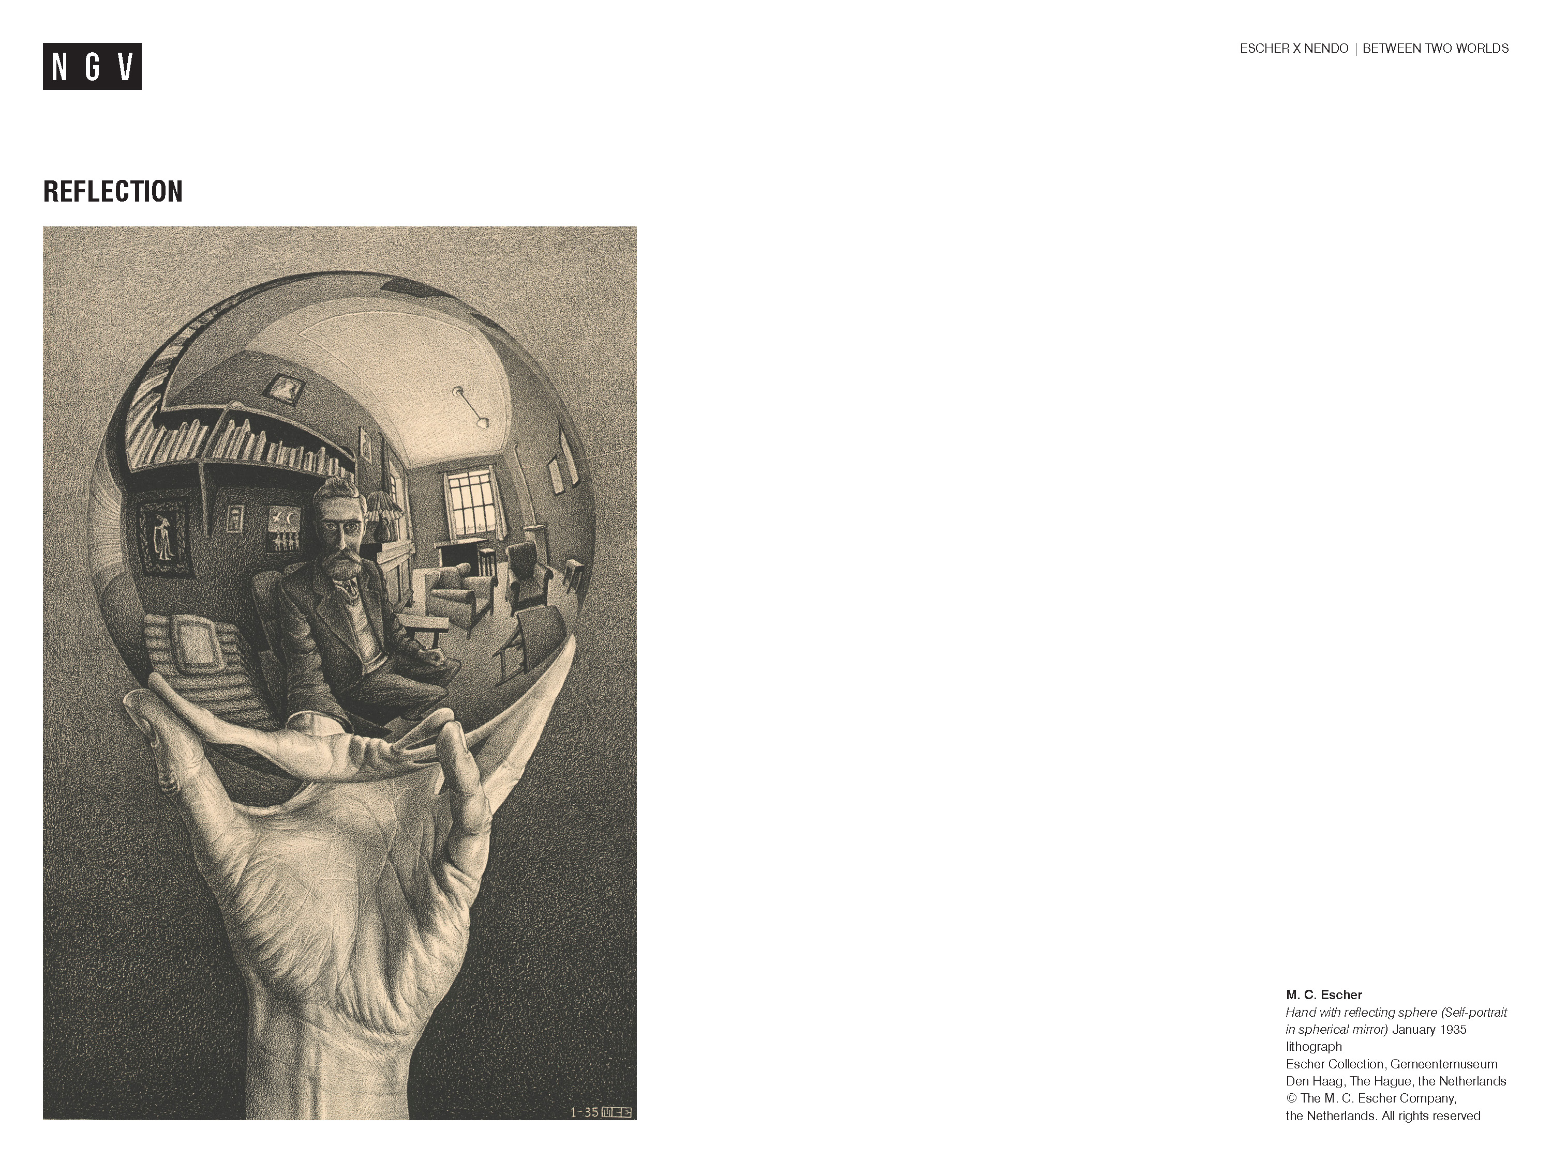
Notes:
Share this information with your students:
This is one of Escher’s most famous self-portraits, Hand with reflecting sphere, January 1935.
Ask students:
Why do you think Escher’s portrait has become so famous?
Share this information with your students:
At first glance, we see a hand holding a mirrored sphere. Sitting in his studio in Rome, the artist is reflected in the sphere. As we continue to look at the portrait, we realise that Escher is playing with perspective. Is he looking at himself, or us, or are we supposed to imagine ourselves as Escher?
Not only does he show his talent at creating visual effects like this, but also the tremendous amount of skill needed in depicting reflective surfaces. In this print, Escher's image is reflected in a convex, or curved, mirror. In a convex mirror, images appear to be smaller and a wider view is reflected.
Ask students:
Can you think of examples where we see convex mirrors? For example, rear view mirrors in cars.
Have a closer look at Escher's expression. What could he be thinking? Escher is looking directly at us, with confidence and self-assurance. What is something you are confident in?

Slide 6
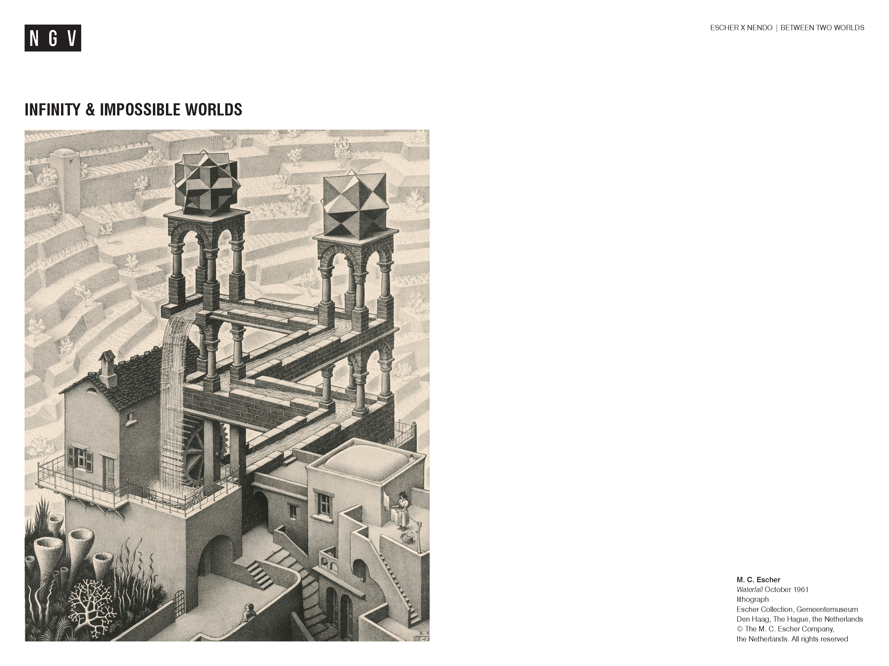
Notes:
Ask students:
Follow the stream of water with your finger. What do you notice?
What can you see that is common in everyday life? Which objects might you find strange/oddly placed and why?
What words would you use to describe this place?
Share this information with your students:
Escher was inspired by the impossible object, the Penrose triangle, to create some of his impossible worlds. In Waterfall, Escher used the design of three impossible triangles to create the tower and channel of water. At first, you see a place that is believed to be real but, if you look closer, you soon start to realise that it is impossible. Begin by looking at the upper left of the tower. The falling water keeps a wheel turning and subsequently flows along a sloping channel. The water appears to flow downwards and, at the same time, away from us in a zig zag-like pattern, until it reaches the waterfall again. The stream of water seems to flow on, and on, and on...for infinity!

Slide 7
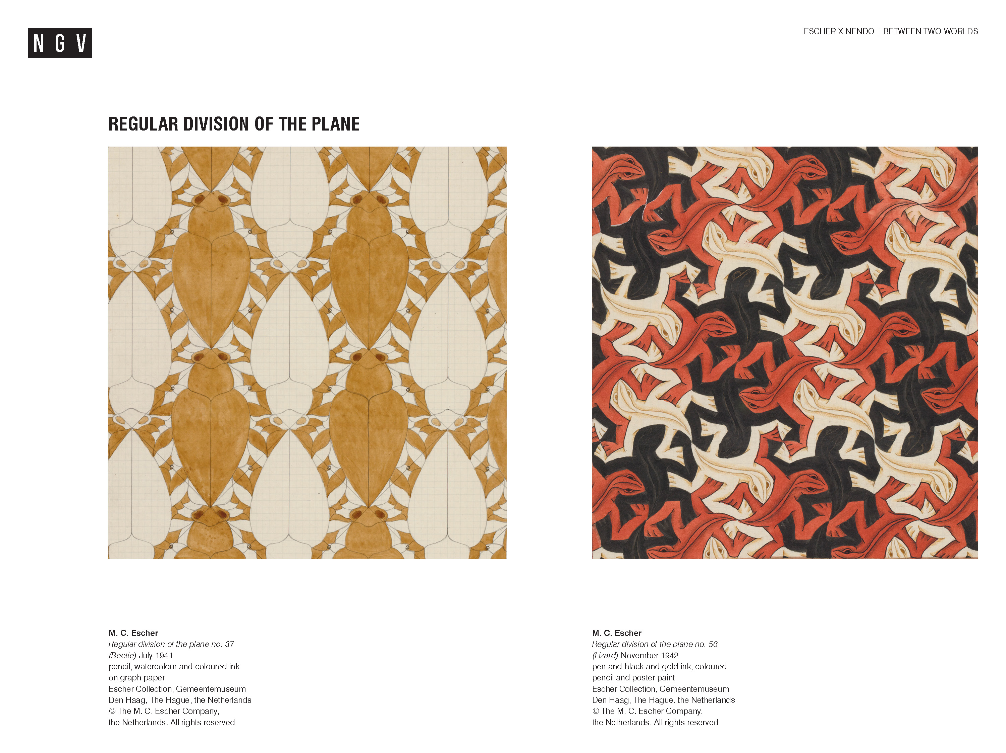
Notes:
Ask students:
What are the similarities and differences between these two images?
How has Escher arranged the shapes of animals?
Share this information with your students:
Escher also travelled to Spain for holidays. He visited the Alhambra, a Moorish castle in the Spanish city of Granada. As he explored the palace, Escher was inspired by the Moorish architecture and the colourful, tessellating patterns of the tiles. A tessellation is a pattern of shapes that fit together without any gaps or overlap, just like a puzzle. He spent days sketching these patterns in his sketchbook. Escher then began to explore tessellations further in his series of work, Regular Divisions of the plane. Escher would fill a plane, or surface, with tessellating shapes, mostly of animals like birds, fish and reptiles. The tessellations of the Alhambra palace piqued Escher’s interest in exploring Mathematical ideas and how they could be included in his artwork.
Ask students:
Can you find examples of tessellating patterns in the room or in the environment?
Escher developed a passion for some of the concepts that mathematicians explored, such as patterns, symmetry, geometry and infinity.
Can you think of other examples where we see Maths and Art intertwined?

Slide 8
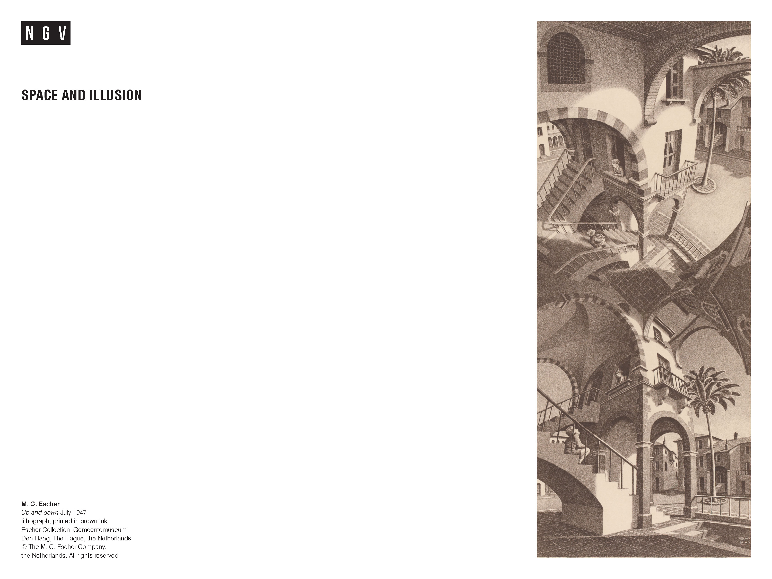
Notes:
Activity:
Group students in pairs. Ask Partner A to close their eyes. Show Escher's print to partner B. Allow 60 seconds for partner B to look at the image, then hide/remove the image. Ask partner B to describe Escher's work of art to partner A (who hasn’t seen the image).
Some question prompts to help:
What objects can you see in the work of art?
Are there any sections that are repeated in the image?
How many staircases can you see?
Show Escher's print to all students.
Can you add to your partner's description? What else can you see? Can this world exist? Why/why not?
Share this information with your students:
Escher really wanted to show people a new way of seeing the world - he wanted to make the impossible seem possible. For example; up becomes down, down becomes up, buildings bend and twist, and staircases appear to go on forever! In this print, Escher drew at least three different views of the building and stairs. Follow the staircases and see where they take you. Escher's imagination and curiosities continue to grow through continuous experimentation and practise in drawing and printmaking.

Slide 9
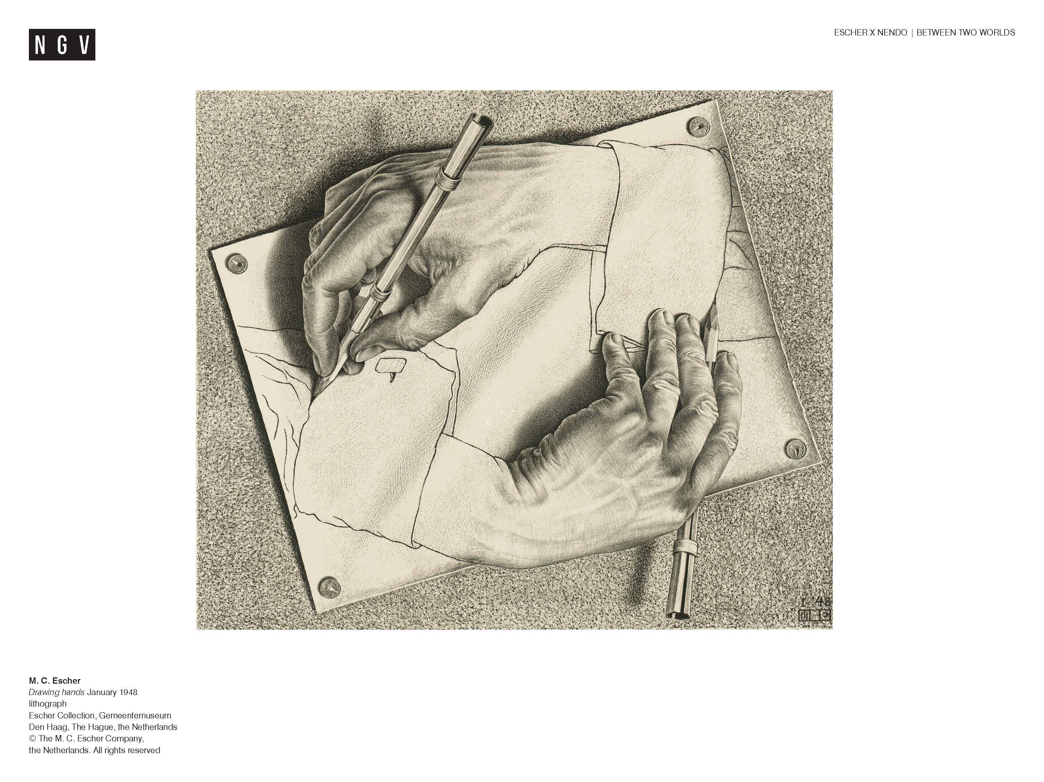
Notes:
Let’s get philosophical…
Ask students:
Describe Escher’s print. Which hand is doing the drawing and which is being drawn?
Share this information with your students:
The answer is a contradiction; when something is the complete opposite of something else. Both hands are drawing each other at the same time, which means that we can’t be certain which hand is the drawer and which is being drawn. This is called a paradox; a situation or statement that seems impossible or is difficult to understand because it has two opposite or contradicting facts or characteristics.
Can you think of a contradicting statement? For example, declaring to be an environmentalist and living sustainably, but always forgetting to recycle!
Further activity:
He who wonders discovers that this in itself is wonder.¹
M.C Escher
¹ M. C. Escher, The Graphic Work of M. C. Escher, revised and expanded edn, trans. John E. Brigham,
Oldbourne, London, 1967, p. 10.
Share the quote above with your students.
Ask students:
What did Escher mean by this? Discuss with the person next to you.
How did Escher’s curiosities and wonderings help him as an artist? How important is it to wonder or be curious in your life?
What are some aspects of Escher’s work that have fascinated/interested you? Why?
What are you looking forward to seeing in the exhibition? Why?

